Slide 1

Flight Delays Predictive Analysis
Randy Chan
Saifee Dalal
Sandeep Komuravelli
Deepti Shandilya
Ghassan Aleqabi
Aparna Paul

Slide 2

Background
Flight cancellation and delay is a very common problem in the real world. It can have a negatively financial impact both the airlines and passengers. Furthermore, it will also impact personal scheduled events and commitments. A passenger who is delayed on a multi-plane trip could miss a connecting flight. Key Impacts:
Bad customer satisfaction
Financial losses and negative reputation for airlines
Inconvenience for passengers and impacting personal scheduled events

Slide 3

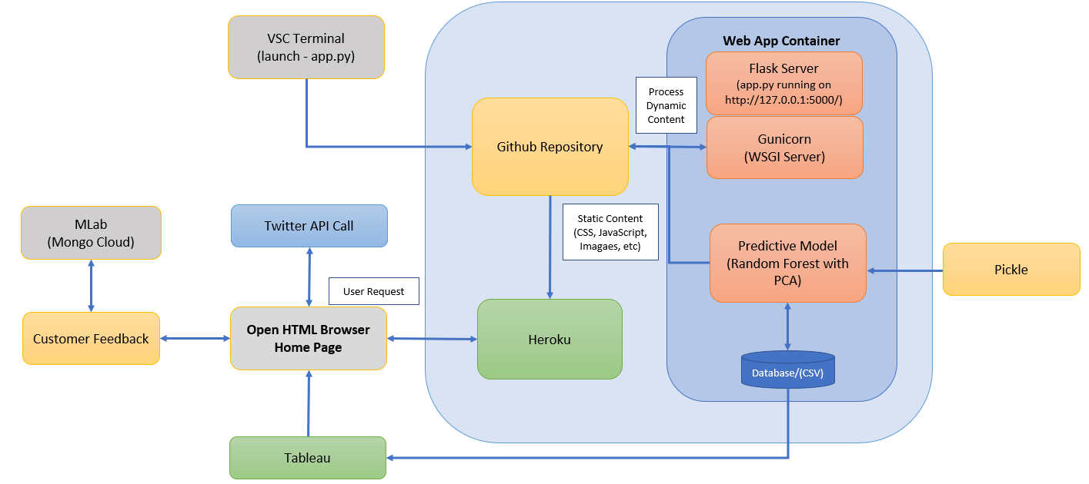
Data/App Architecture

Slide 4

Data Source/Data Cleanup
Data Cleanup
Removed Null Values
Re-balanced Class
Removed Sparse Variables
Removed collinear variables
Removed Multicollinear variables
Bureau of Transportation Statistics (BTS) is a politically objective supplier of trusted and statistically sound baseline, contextual, and trend information. BTS is the preeminent source of statistics on commercial aviation, multimodal freight, and transportation economics.
2 Years worth of data is downloaded and complied for this project. The total file size prior to any data cleanup and manipulation is 5.24GB

Slide 5
Predictive Analysis with Machine Learning
Approach
Wrangle data:
Check for class imbalances and handle it by sampling from the dataset
Check for sparse columns to remove them
Check for columns with a few missing values to impute with zero, mean or median
Encode categorical values to numerical values
Exploratory analysis:
Infer distribution of data using histograms
Use measures of central tendency and IQR to understand data at various positions
Variable interdependence: Infer multicollinearity of data through correlation matrix
Feature selection: Remove redundant variables (i.e. columns that refer to the same thing e.g. ID)
Feature engineering:
Remove highly collinear variables (i.e. correlation > 0.8)
Reduce data dimension to the variables that most explain variation in target variable
Modeling building: Random forest is chosen for machine learning modeling
Model comparison: Random forest modeling with raw data and PCA transformed data
Machine learning process:
Train/test data: Split data for training and testing
Model creation: Create models in a grid search for a combination of parameters
Model selection: Use 3-fold cross validation to evaluate model performance and select the best one
Final Model training: Use parameters of the best model from above to train on entire train set
Final Model evaluation: Use 3-fold cross validation for average error on 3 folds of training data
Final Model performance evaluation: Use confusion matrix, Precision, Recall, ROC to evaluate performance

Slide 6
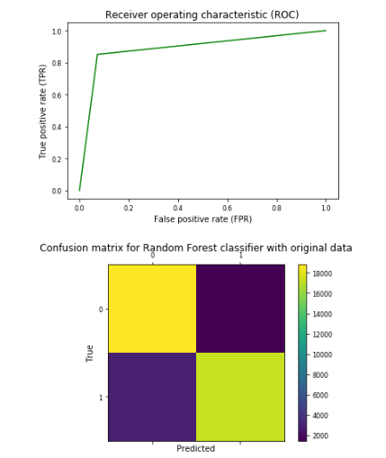
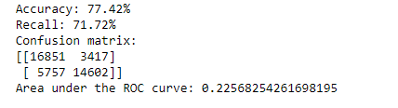
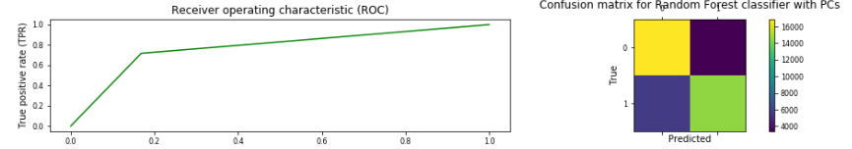
Model Result
Redundant and Collinear Data
Random Forest Model Accuracy
PCA with Low Multi-Collinearity

Slide 7
Challenges
This project started out as a very simple concept to predict flight delays. We soon find out that the complexity is well beyond our expectations. We have run into many challenges that impacted our timeline for deployment.
Large data set with too many features
Low accuracy due to limited data being fed to the model (time and performance restriction)
Initial coarser search followed by finer grid search can help in identifying optimal model parameters that can enable prediction with higher performance.
Sampling of data to avoid class imbalance resulted in discarding a lot of data. In this problem, regression imputation is suggested as mean and zero imputation did not provide good results.
Feature transformation could have been explored by deriving new features from existing data such as Airport/Airline delay from taxi duration or wheels on/wheels off. This would have provided much more intuitive analysis results.
Lastly and more importantly, grid search with more trees in Random Forest is essential and is highly likely to give improved results

Slide 8
Future Enhancement/Opportunities
There are many factors that impact airline on-time departure. Our current model barely covers the basic. The more features being fed to the model and the more data being included will improve the accuracy of our model. Our model is using Random Forest as the machine learning model. Exploration on other Machine Learning methodology may also produce much different result.
Enhancement on Machine Learning:
Encompass addition features into our Machine Learning Model
Increase the amount of data that is used for our train model to improve accuracy
Run additional Machine Learning models to compare results
Enhancement on Historic Trend Data Visualization
Better breakout of display to segregate data into key categories such as (location, airline, date, time, etc.)
Integration with other data set (such as weather and pricing) to provide more in-depth analysis on flight delays

Slide 9

This is the end of our journey
We have arrived our destination!

